Slide 1
Theory of Irregular Cuboids and Non-Cuboids
COLL 134
Week 14

Slide 2
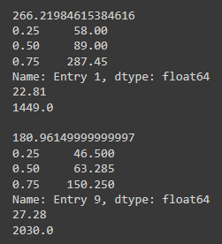
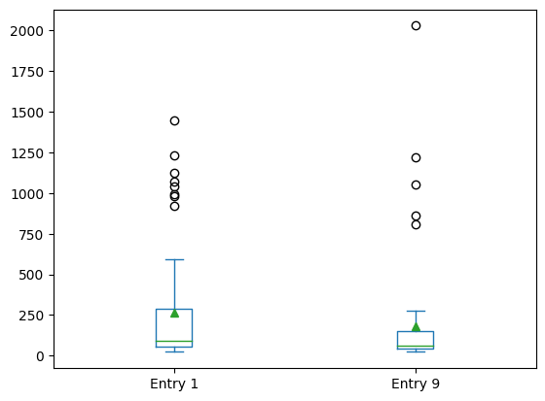
Semester Statistics
Entry 1
Mean: 4:26.22
Best: 22.81
Q1: 58.00
Median: 1:29.00
Q3: 4:47.45
Worst: 24:09.00
Entry 9
Mean: 3:00.96
Best: 27.28
Q1: 46.50
Median: 1:03.28
Q3: 2:30.25
Worst: 33:30.00

Slide 3
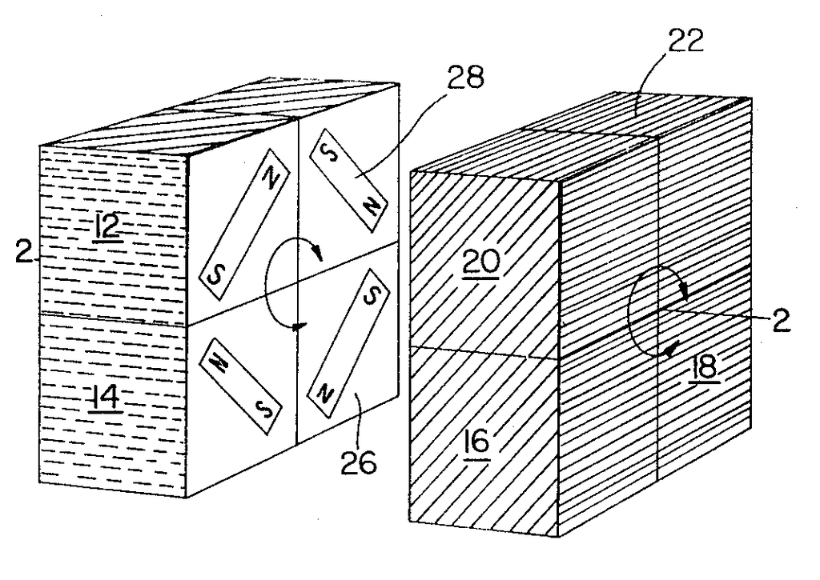
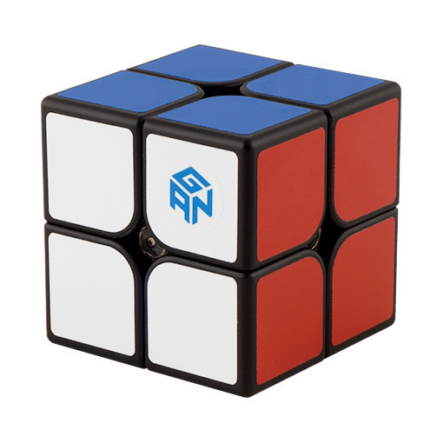

2x2 (Pocket Cube)
Invented by Larry Nichols
1957 (conception) -> 1968 (prototype) -> 1972 (patent)
“3x3 but corners only”
Corner permutation
Corner orientation
Spatial orientation
Total
$$8!∗3^{7}∗\frac{1}{24}=3,674,160$$

Slide 4
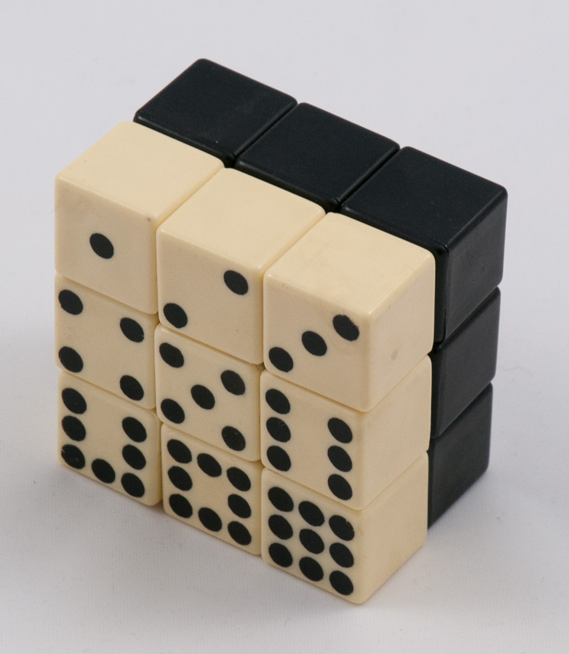
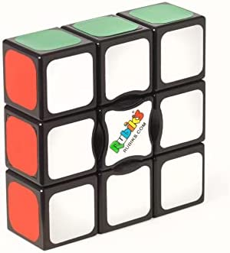
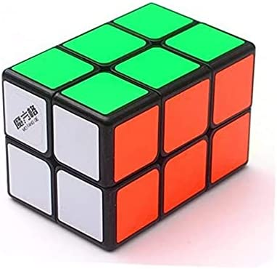
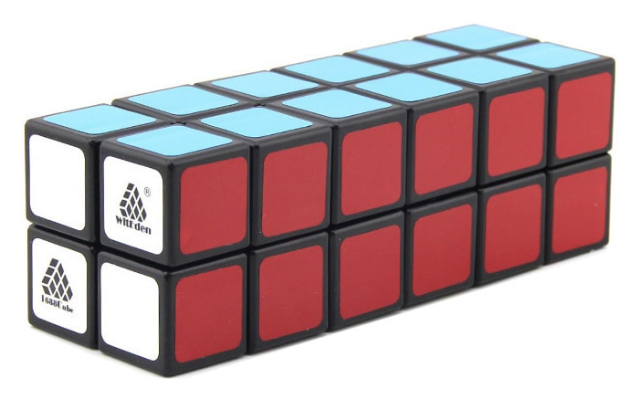
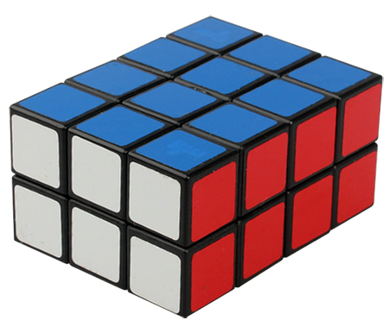
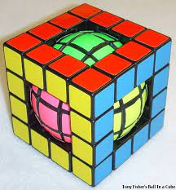
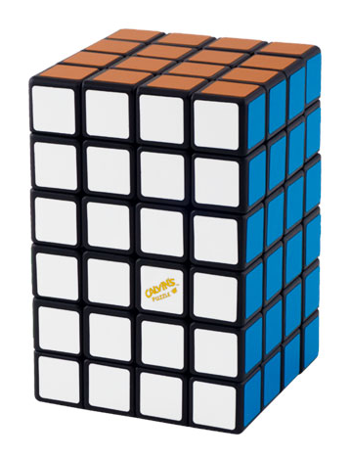
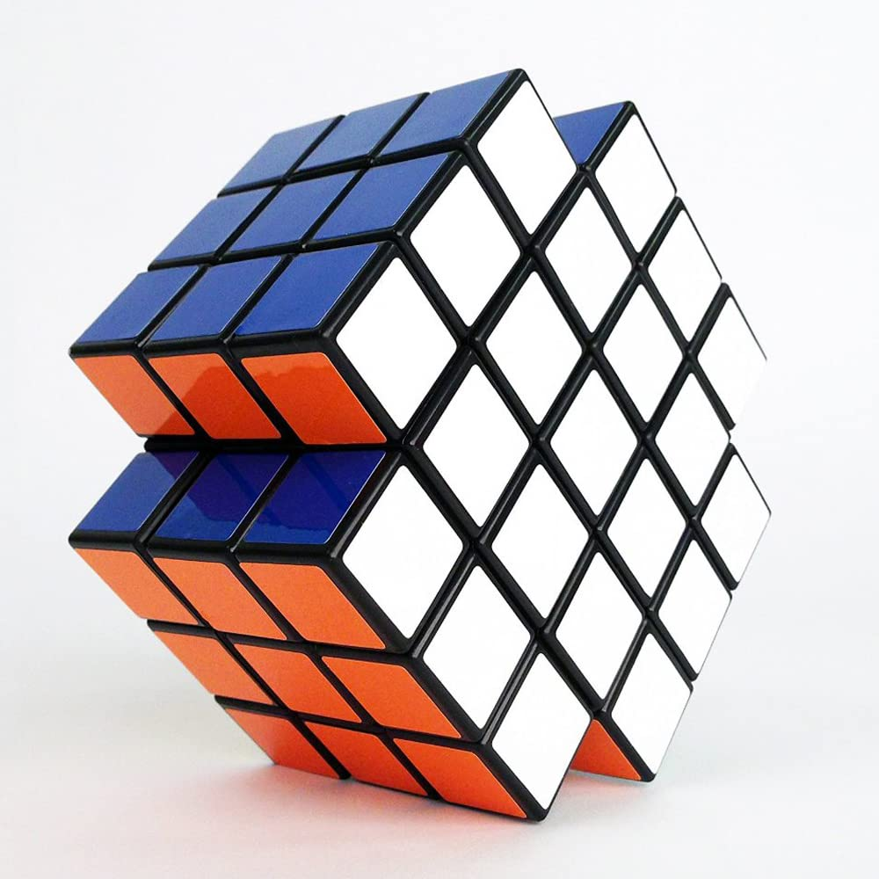
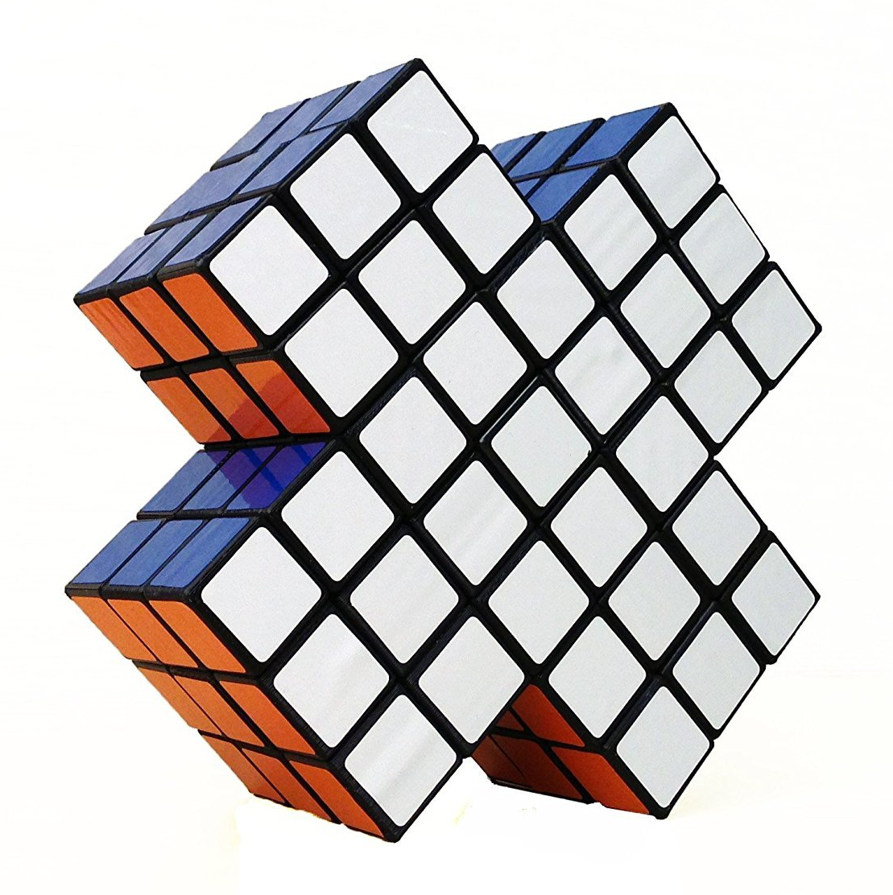
Different Kinds of NxN Puzzles
1x3x3 “Floppy Cube”
2x2x3 “Tower Cube”
2x2x6
2x3x3 “Rubik’s Domino”
2x3x4
Tony Fisher’s
Ball in a Cube
4x4x6
X-Cube
X2/X-Cube Master

Slide 5
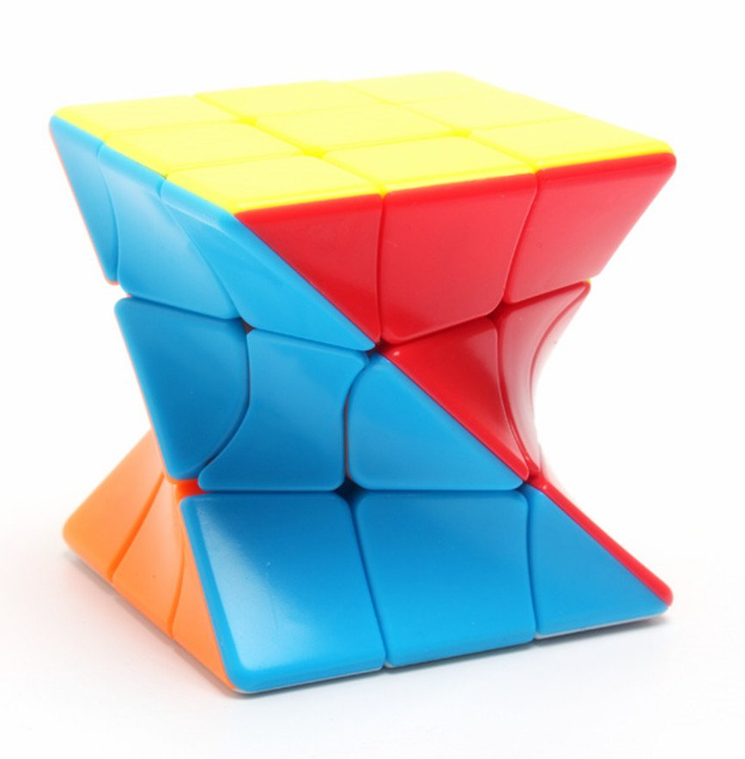
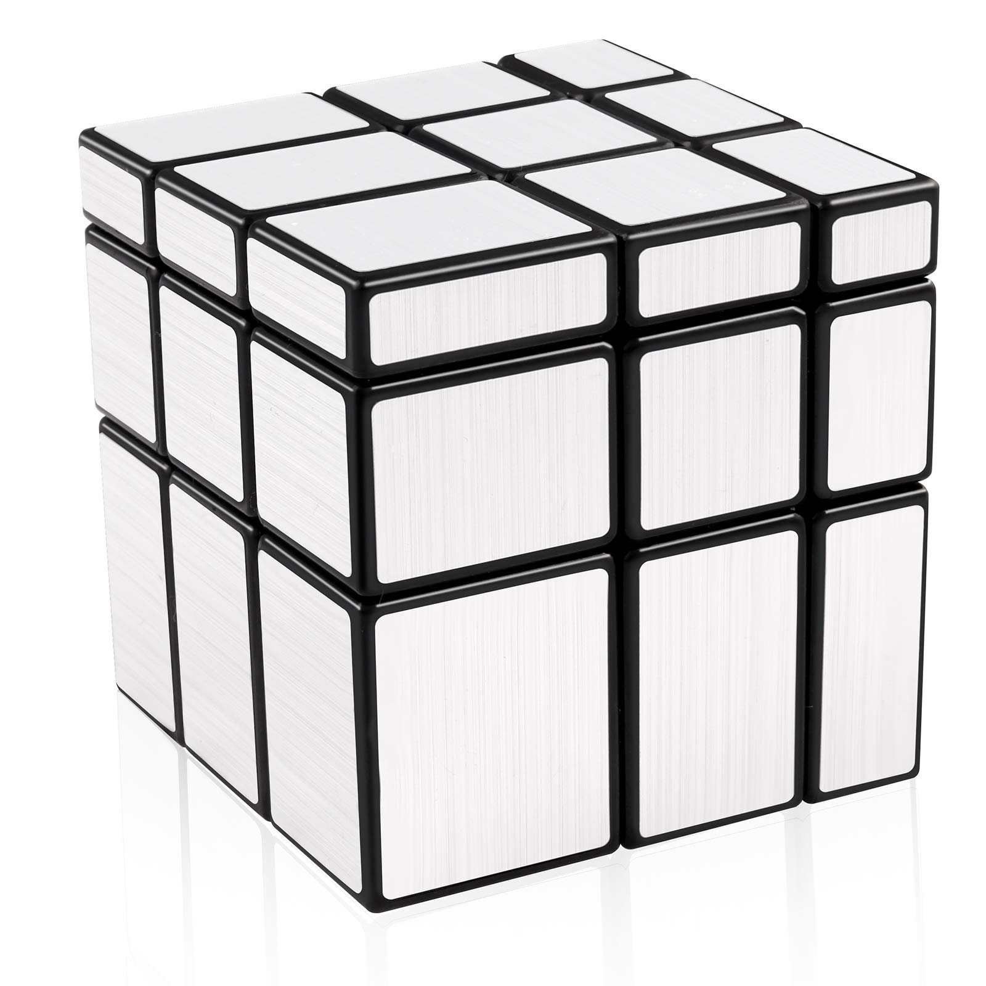
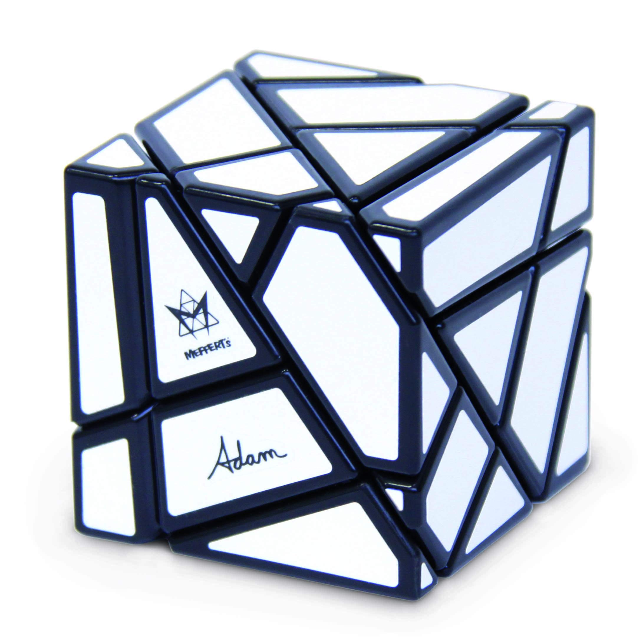
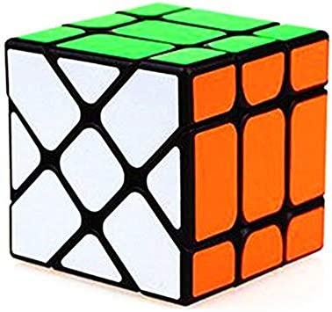
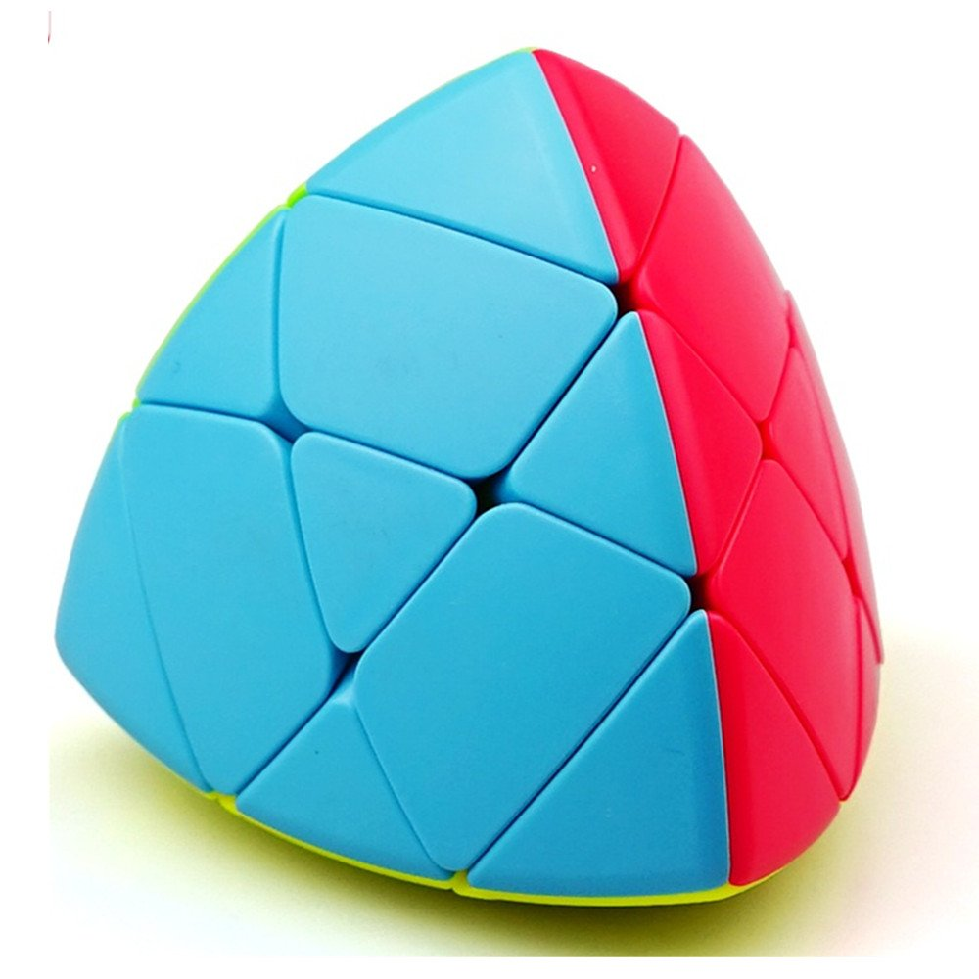
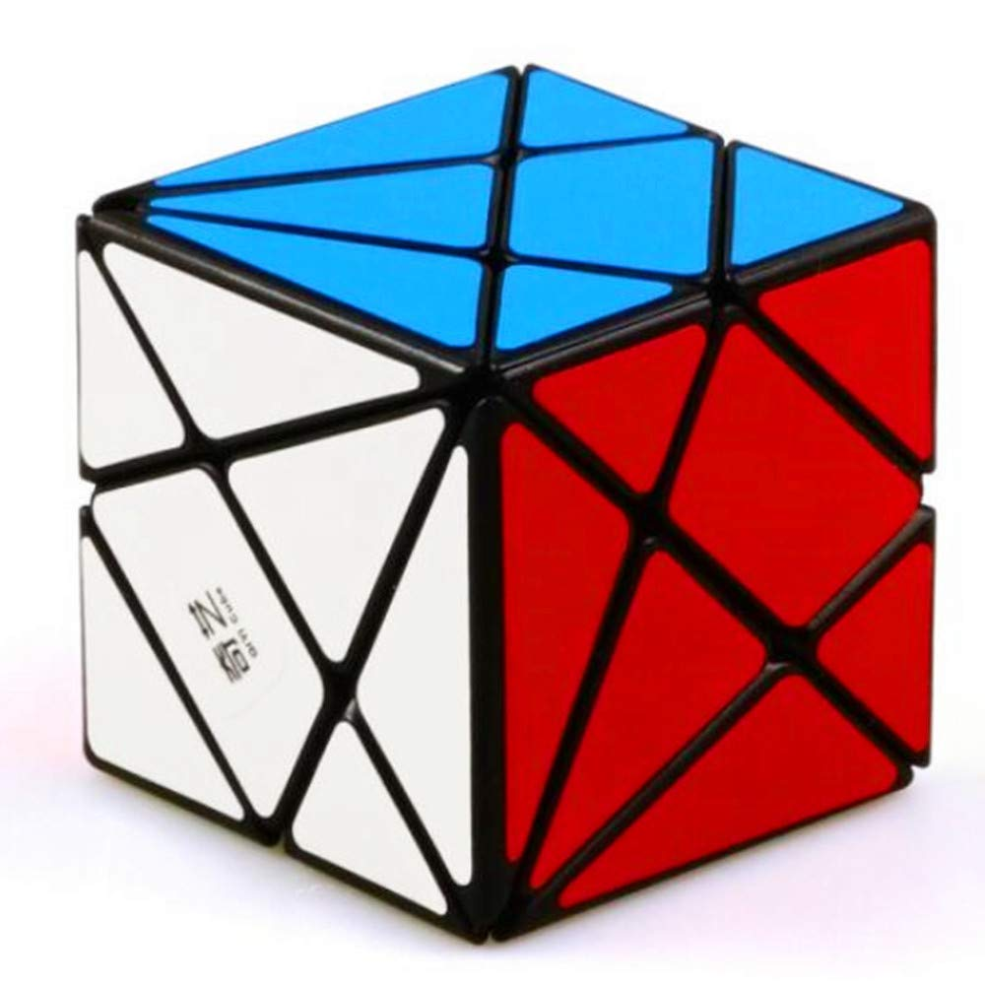
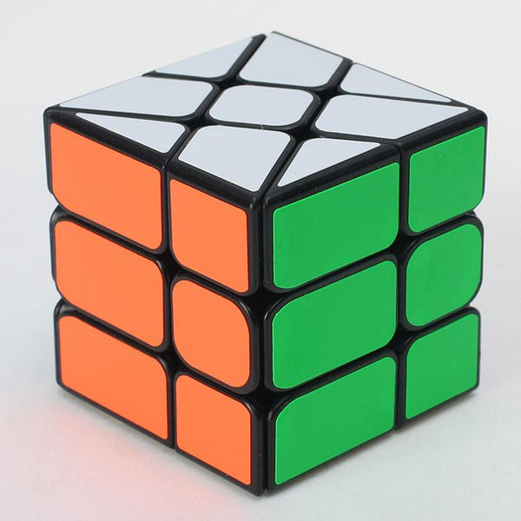
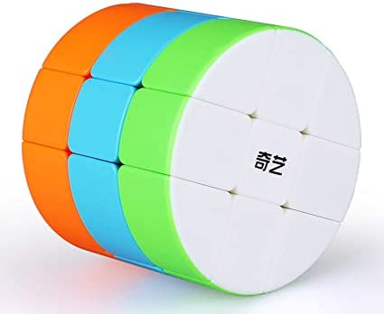
3x3 Shape Modifications
Mirror Cube
Twist Cube
Ghost Cube
Fisher Cube
Barrel Cube
Mastermorphix
Axis Cube
Windmill Cube

Slide 6
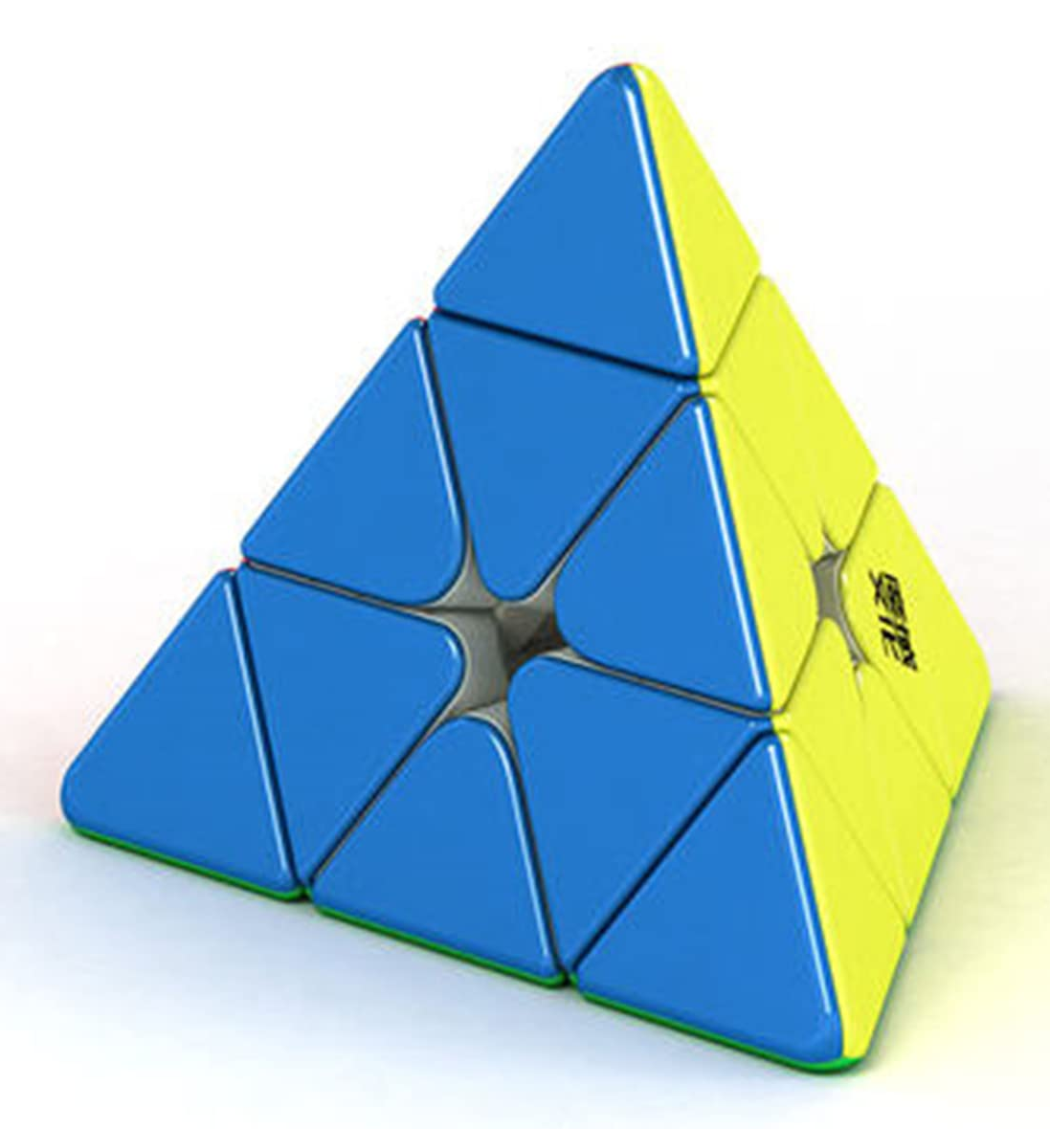
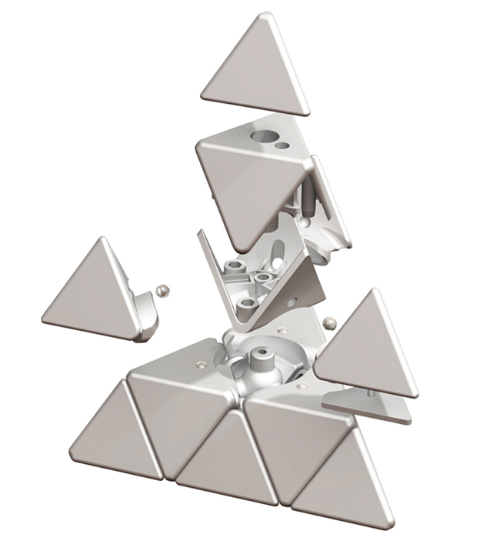
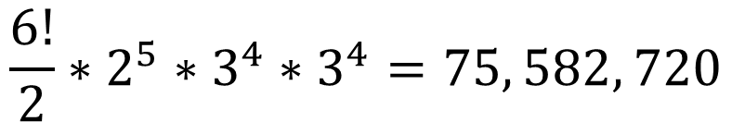
Pyraminx
x4 corners
x4 centers
Invented by Uwe Mèffert
Tetrahedron
4 axes of rotation
120º turns
x6 edges
Edge permutation
Edge orientation
Center orientation
Corner orientation
Total
$$\frac{6!}{2}∗2^{5}∗3^{4}∗3^{4}=75, 582, 720$$

Slide 7
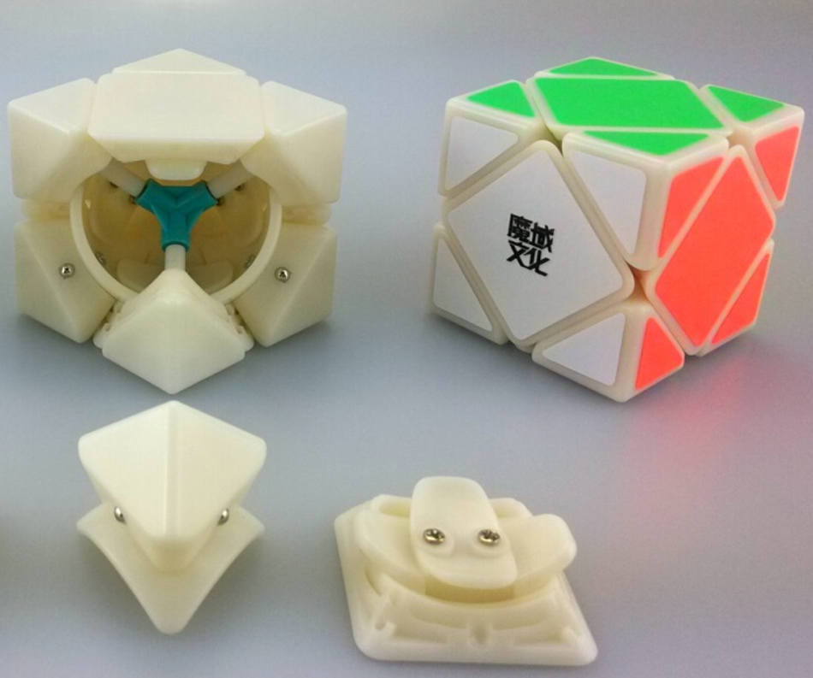
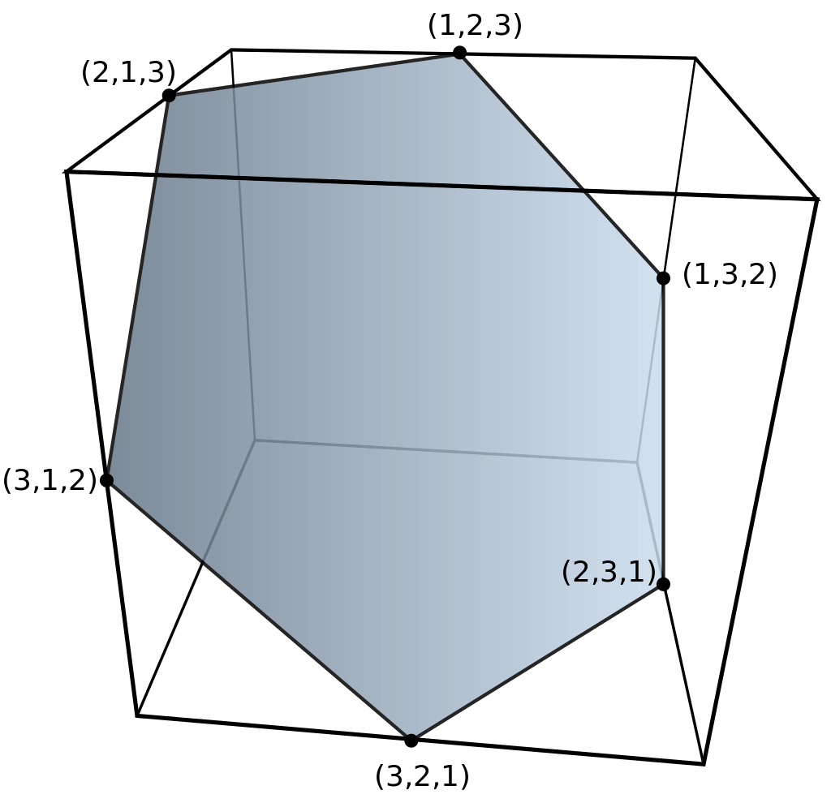
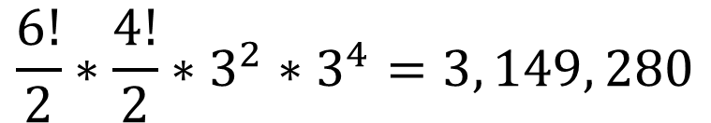
Skewb
x4 fixed corners
x4 floating corners
Invented by Tony Durham
Cubic version of pyraminx
4 axes of rotation
120º turns
x6 centers
Center permutation
Floating corner permutation
Floating corner orientation
Fixed corner orientation
Total
$${\frac{6!}{2}∗\frac{4!}{2}∗3}^{2}∗3^{4}=3, 149, 280$$

Slide 8
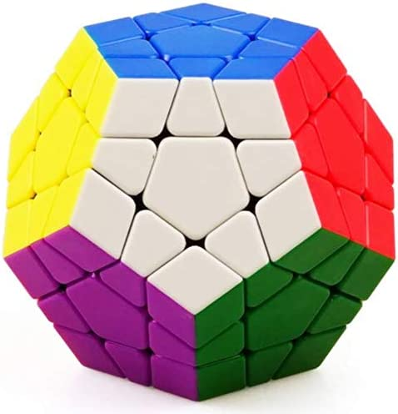
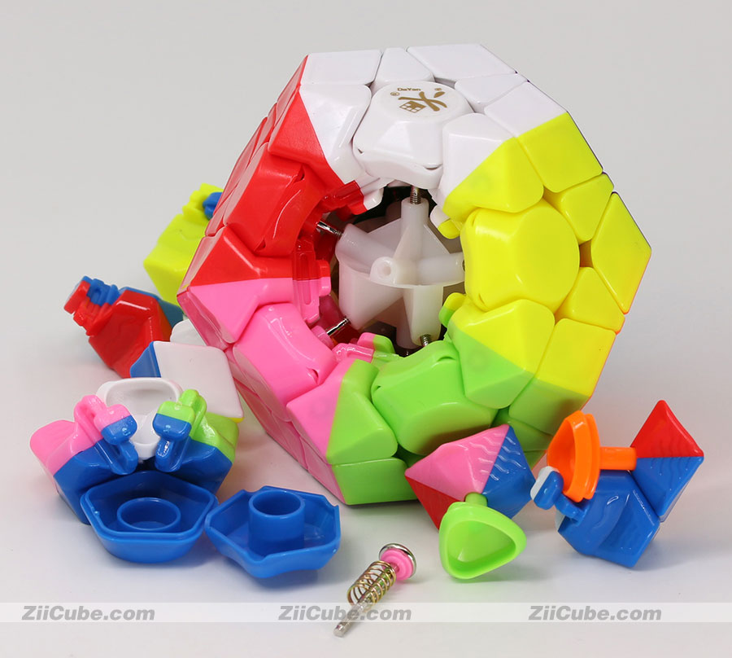
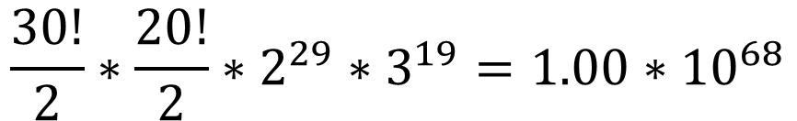
Megaminx
x30 edges
x12 centers
Invented by Uwe Mèffert, Christoph Bandelow, etc. (disputed)
Dodecahedron
12 axes of rotation
60º turns
x20 corners
Edge permutation
Corner permutation
Edge orientation
Corner orientation
Total
$$\frac{30!}{2}∗\frac{20!}{2}∗2^{29}∗3^{19}=1.00∗{10}^{68}$$

Slide 9
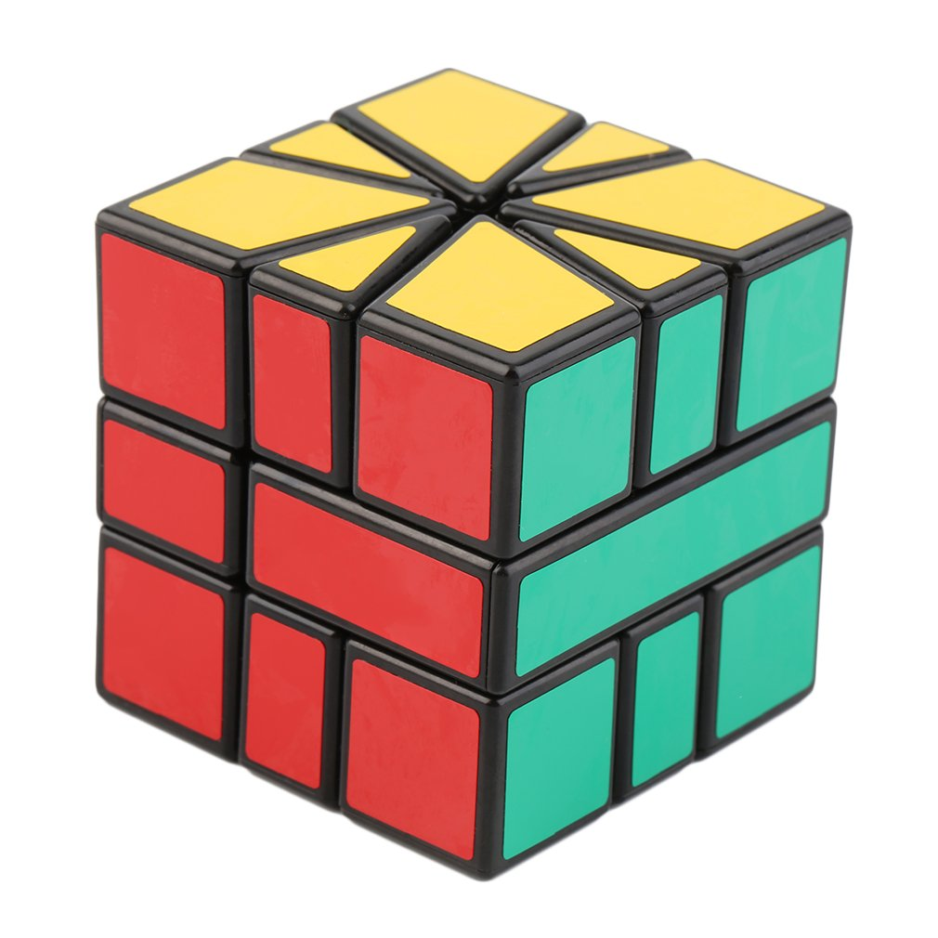
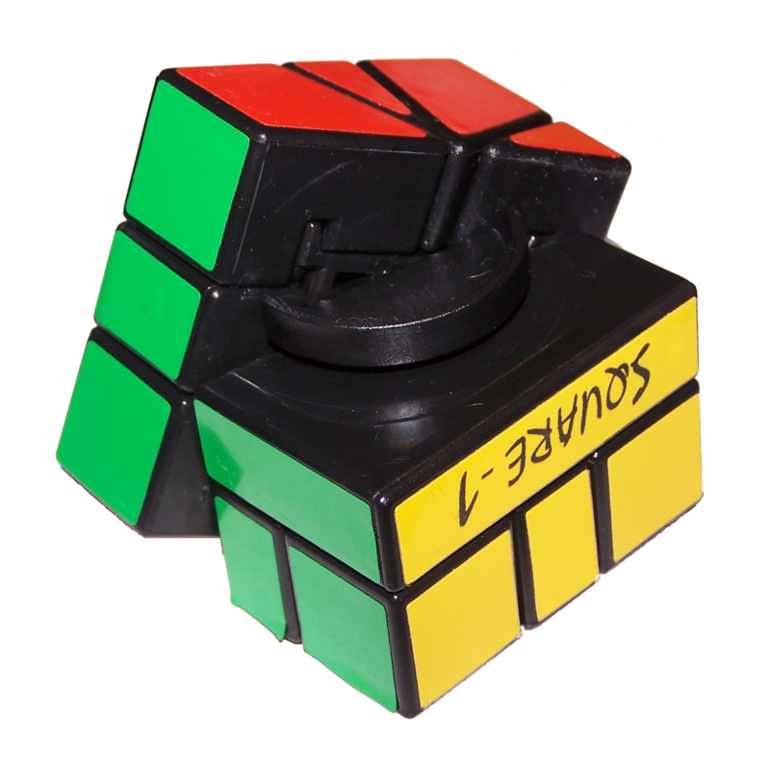
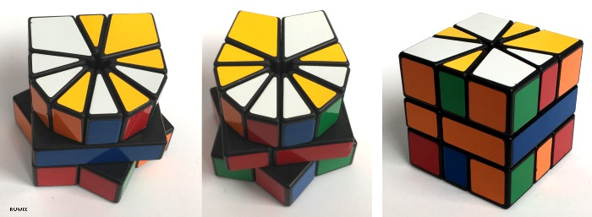

Square-1
x8 corners
x8 edges
x2 middle slices
Invented by Karel Hršel and Vojtěch Kopský
Cube
3 axes of rotation
30º/60º turns on U and D layers
180º turns on vertical slice
Total
$$11, 958, 666, 854, 400$$

Slide 10
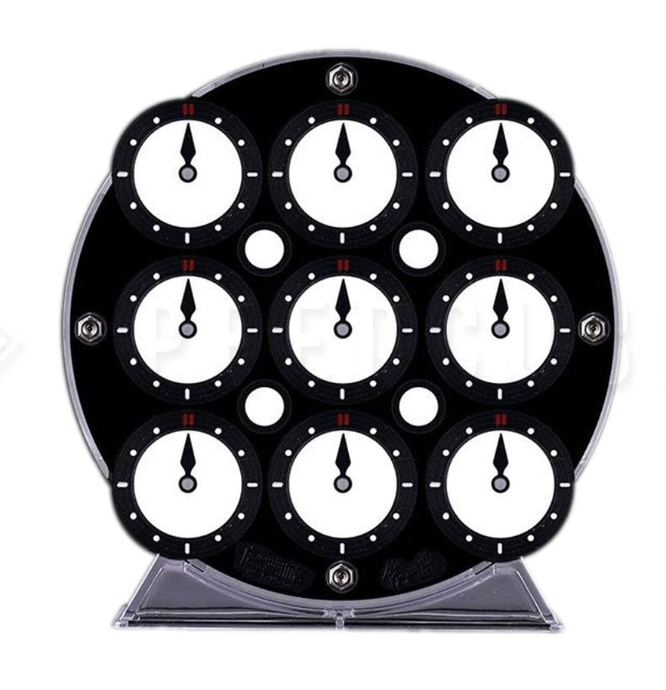
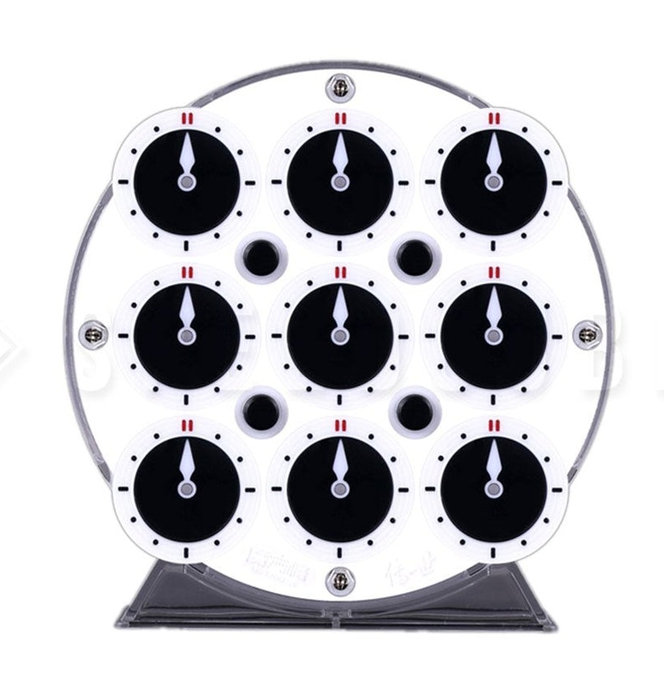
Clock
x4 corners
x2 centers
x8 edges
Invented by Christopher Wiggs and Christopher Taylor
“Circle”
30º turns
Corner clocks are connected front/back
Edge and center clocks are separated front/back
4 dials rotate clocks on each side
4 pins control clock connectivity
Clock orientation
Total
$${12}^{14}=1, 283, 918, 464, 548, 864$$

